Slide 1


Lecture 19
Implementing Web Computing Models Controls and Components
(Continued)
Server Control and User Control

Slide 2
Chapter 5 Outline: Application Building
Web Programming Models
Web Application Architecture
Web Application Controls and Components
Server Controls (HTML and Web Controls)
User Controls
Web Configuration
DLL
Web Application State Management
Global Control
Cookies, Session State, Application State
Server side file system
Dynamic Graphics, Animation, Mobile Computing
L18
L19

Slide 3
(4) Implementing Web Computing Model Server-Side Computing:
Use of Server Controls
<% Page Language
<!DOCTYPE html
<html>
…
</html>
ASPX forms Postback
<html>
…
…
</html>
<html>
…
…
</html>
ASPX.cs
Run at Server

Slide 4
Server-Side Scripting Using HTML Control
<html>
<head runat="server">
<title>Server Side Script</title>
</head> <body >
<form id="Form1" RunAt = "Server" >
<input id="Text1" type="text" RunAt = "Server" />
+
<input id="Text2" type="text" RunAt = "Server" />
<input type="submit" value= " = "
ID = "z"
OnServerClick = "OnAdd"
RunAt = "Server" />
</form>
</body> </html>
<script language= "C#" runat="server">
void OnAdd (Object sender, EventArgs e) {
Int32 x = Convert.ToInt32(Text1.Value);
Int32 y = Convert.ToInt32(Text2.Value);
z.Value = Convert.ToString(x + y);
}
</script>
Code separated from the html part

Slide 5
View Page Source: Program not visible
<html>
<head><title>Server Side Script</title></head> <body >
<form name="Form1" method="post" action="Default.aspx" id="Form1">
<div>
<input type="hidden" name="__EVENTTARGET" id="__EVENTTARGET" value="" />
<input type="hidden" name="__EVENTARGUMENT" id="__EVENTARGUMENT" value="" />
<input type="hidden" name="__VIEWSTATE" id="__VIEWSTATE" value="/wEPDwUKLTkzMzQ0OTIwNg9kFgICAw9kFgICBQ8WAh4FdmFsdWUFAjU1ZGSVLB7EHEiZszM7bxtX2itVFSK2oA==" />
</div>
<script type="text/javascript">
//<![CDATA[var theForm = document.forms['Form1'];
if (!theForm) {
theForm = document.Form1;
}
function __doPostBack(eventTarget, eventArgument) {
if (!theForm.onsubmit || (theForm.onsubmit() != false)) {
theForm.__EVENTTARGET.value = eventTarget;
theForm.__EVENTARGUMENT.value = eventArgument;
theForm.submit();
}
}
//]]>
</script>
<div>
<input type="hidden" name="__EVENTVALIDATION" id="__EVENTVALIDATION" value="/wEWBALd0uq2CQLzlKGwCgL2lKGwCgKmuYiBBSKn5+tsAi8rGZvqAijK+zePk9vB" />
</div>
<input name="Text1" type="text" id="Text1" />
+
<input name="Text2" type="text" id="Text2" />
<input name=“z" type="submit" id=“z" value=" = " />
</form>
</body>
</html>

Slide 6
Server-Side Scripting Using Web Controls
Default.aspx
<html>
<head runat="server"><title>Server Side Scripting</title></head>
<body>
<form runat="Server">
<asp:TextBox ID= "x" RunAt="server" />
+
<asp:TextBox ID= "y" RunAt="server" />
<asp:Button Text= " = " OnClick = "OnAdd" RunAt= "server" />
<asp:Label ID= "z" RunAt="server" />
</form>
</body>
</html>
<script language= "C#" runat="server">
void OnAdd (Object sender, EventArgs e) {
Int32 a = Convert.ToInt32(x.Text);
Int32 b = Convert.ToInt32(y.Text);
z.Text = (a + b).ToString();
}
</script>
Another possible way
Default.aspx.cs

Slide 7
What You Can View in the Browser?
You can only view html file when you use View Source Command to view .aspx file -- an html file will be generated:
<html>
<head><title>Server Side Script</title></head>
<body>
<form name="ctl01" method="post" action="Default.aspx" id="ctl01">
<div>
<input type="hidden" name="__VIEWSTATE" id="__VIEWSTATE" value="/wEPDwUKMTEyMTc3MTQwNmRkOe6HlUJeEG0Cgou4jwHq01wxrh8=" />
</div>
<div>
<input type="hidden" name="__EVENTVALIDATION" id="__EVENTVALIDATION" value="/wEWBALs1vneBQLY76ruDALX76ruDAKgwImNC2NBATXZ/Ocwvoc/1d9t+umwEVP6" />
</div>
<input name="x" type="text" id="x" />
+
<input name="y" type="text" id="y" />
<input type="submit" name="ctl03" value=" = " />
<span id="z"></span>
</form>
</body>
</html>
This approach is similar to abstract data type/class: Data are private, and has to be accessed via a method.

Slide 8
Adding exception handler in the .aspx page
In the previous form, if a noninteger is entered, the form will return an “uncaught exception”. In aspx, one can add an exception handler to catch the error:
<script language= "C#" runat="server">
void OnAdd (Object sender, EventArgs e) {
try {
Int32 a = Convert.ToInt32(x.Text);
Int32 b = Convert.ToInt32(y.Text);
z.Text = (a + b).ToString();
}
catch (FormatException) {
z.Text = "Please enter integers only";
}
}
</script>

Slide 9
(5) Implementing Web Computing Model AJAX
<% Page Language
<!DOCTYPE html
<html>
…
</html>
ASPX forms
With AJAX
<html>
…
…
</html>
ASPX.cs
Run at Server

Slide 10
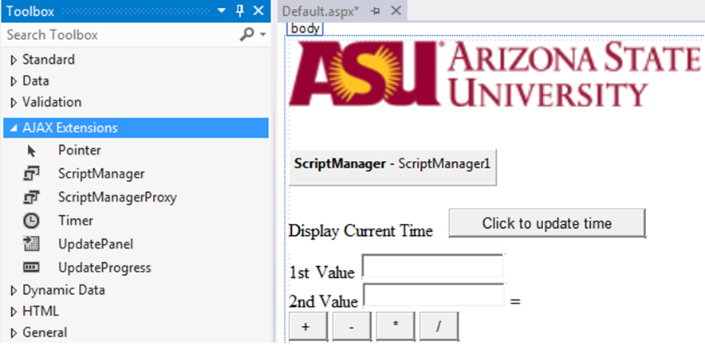
Example: AJAX Web Controls
Define the area in which partial data refresh is allowed
Label
23
Click Button
17
Define a second panel

Slide 11
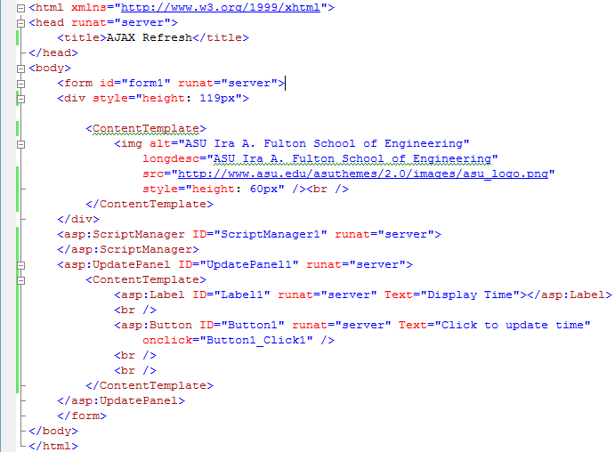
Example: AJAX Web Controls
What control does the form belong to?
Server control or user control?
Web control or html control?

Slide 12
Can I display XML format without Writing an XSL program?
How?
Use Server Controls!
Are they better than my XLS program?

Slide 13
Using Web Controls to Display XML File
<html xmlns="http://www.w3.org/1999/xhtml">
<head runat="server"> <title>Display XML File</title> </head>
<body>
<form id="form1" runat="server">
<div>
</div>
<asp:XmlDataSource ID="XmlDataSource1" runat="server"
DataFile="http://venus.eas.asu.edu/WSRepository/xml/Courses.xml"
XPath="/Courses/Course/*"></asp:XmlDataSource>
<asp:GridView ID="GridView1" runat="server" DataSourceID="XmlDataSource1">
</asp:GridView>
<asp:TreeView ID="TreeView1" runat="server" DataSourceID="XmlDataSource1">
</asp:TreeView>
</form>
</body>
</html>
asp:GridView
asp:XmlDataSource
XML
asp:TreeView

Slide 14


GridView and TreeView Web Controls
<asp:GridView ID="GridView1" runat="server"
DataSourceID="XmlDataSource1">
</asp:GridView>
Display the contents at the top level of the tree
<asp:TreeView ID="TreeView1" runat="server"
DataSourceID="XmlDataSource1">
</asp:TreeView>
Display the element names of the XML file

Slide 15
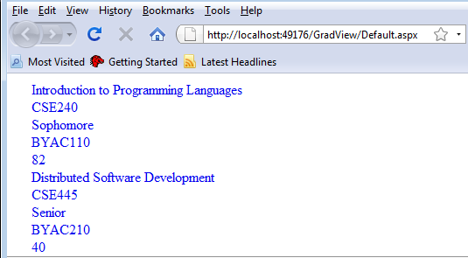
Using DataBinding Control to Display Contents
<asp:XmlDataSource ID="XmlDataSource1" runat="server"
DataFile="http://venus.eas.asu.edu/WSRepository/xml/Courses.xml"
XPath="/Courses/Course/*"></asp:XmlDataSource>
<asp:TreeView ID="TreeView1" runat="server" DataSourceID="XmlDataSource1">
<DataBindings>
<asp:TreeNodeBinding DataMember="Name" TextField = "#InnerText" />
<asp:TreeNodeBinding DataMember="Code" TextField = "#InnerText"/>
<asp:TreeNodeBinding DataMember="Level" TextField = "#InnerText"/>
<asp:TreeNodeBinding DataMember="Room" TextField = "#InnerText"/>
<asp:TreeNodeBinding DataMember="Cap" TextField = "#InnerText"/>
</DataBindings>
</asp:TreeView>
How can you display the header and contents?

Slide 16
Structure of ASP.Net Application
ASPX files and server (html and Web) controls
ASCX files and (Web) user controls
Web.config files containing configuration settings
A Global.asax file containing global application elements
DLL (dynamic link library) files containing custom types employed by the application

Slide 17
What is a (Web) User Control as a Component?
What can be used for building a Web application?
Remote components
Web Services (WSDL and RESTful)
Other Web APIs
Local components
Server Controls and adding code behind
User Controls and adding code behind
Use multiple server controls and even DLL functions
Functions needed frequently
DLL

Slide 18
What is a User Control in ASCX File
A user control is a new “server control” that you build;
It is a custom control (object) built from user code, HTML controls, and Web controls;
It is a mechanism for building reusable ASP.NET components that can be shared by multiple pages. Without using users controls, you may need to repeat the code multiple times.
How can you display the header and contents?
Write your user control to do it

Slide 19
How are User Controls Different?
A User Control consists of a GUI file (.ascx) and a code behind file (.ascx.cs).
Compared with .aspx form: A user control does not create a “form”, and cannot be directly accessed from a browser; Instead, it adds a user-controlled item (a patch) into an ASPX page.
Compared with a Server Control: A Server Control does not have a separate GUI and code files. They are parts within .aspx and .aspx.cs files.
Compared with a DLL function: A user control is not pre-compiled and the just-in-time compilation model can apply. A DLL function does not create GUI.

Slide 20
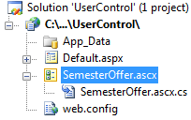
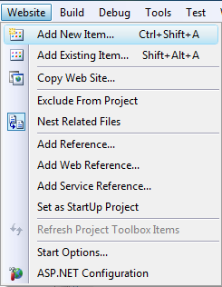
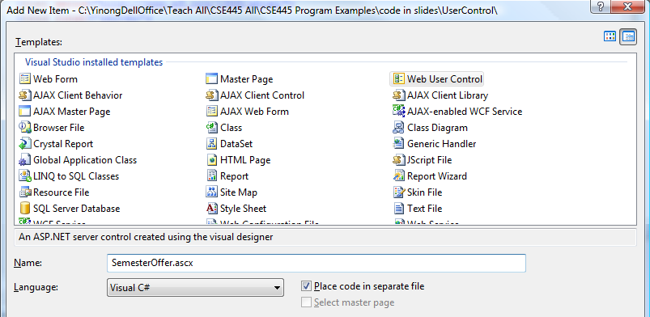
Example: Creating a User Control Item
After you opened your Website project, use VS menu: Website → Add New Item
1
4
2
3

Slide 21
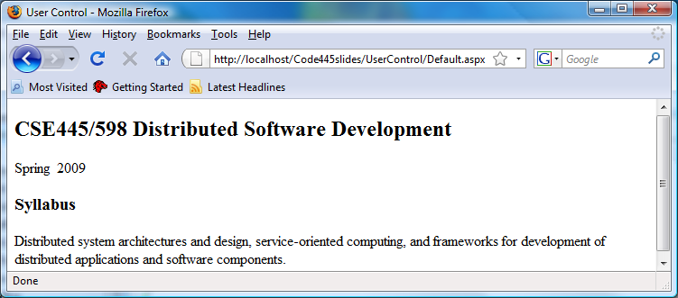
The Purpose: Make a Patch
Fall 2014
This semester and year change automatically.

Slide 22
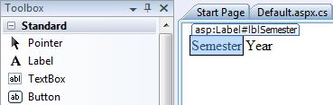
User Control Design: ascx Item
SemesterOffer.ascx
<%@ Control Language="C#"
AutoEventWireup="true"
CodeFile="WebUserControl.ascx.cs"
Inherits="SemesterOffer" %>
<asp:Label ID="lblSemester" runat="server" Text="Semester"></asp:Label>
<asp:Label ID="lblYear" runat="server" Text="Year"></asp:Label>

Slide 23
Write Code behind ascx Item
SemesterOffer.ascx.cs
public partial class SemesterOffer : System.Web.UI.UserControl
{
protected void Page_Load(object sender, EventArgs e)
{
String semester, year;
Int32 m = DateTime.Now.Month;
if (m <= 5) semester = "Spring";
else if (m <= 7) semester = "Summer";
else semester = "Fall“;
Int32 yr = DateTime.Now.Year;
year = yr.ToString();
lblSemester.Text = semester;
lblYear.Text = year;
}
}

Slide 24
Patch an ascx Item into an aspx Page
Default.aspx
<%@ Page Language="C#" AutoEventWireup="true" CodeFile="Default.aspx.cs" Inherits="_Default" %>
<%@ Register TagPrefix = "cse" TagName="semester"
src="SemesterOffer.ascx" %>
<html xmlns="http://www.w3.org/1999/xhtml">
<head runat="server"> <title>User Control</title> </head>
<body>
<h2>CSE445/598 Distributed Software Development</h2>
<form id="Form1" runat = "server">
<cse:semester runat = "server" />
</form>
<h3>Syllabus</h3>
Distributed system architectures and design, service-oriented computing, and frameworks for development of distributed applications and software components.
</body>
</html>

Slide 25
Putting All Together
Deploying a Web Application with a Web User Control
to a Server

Slide 26
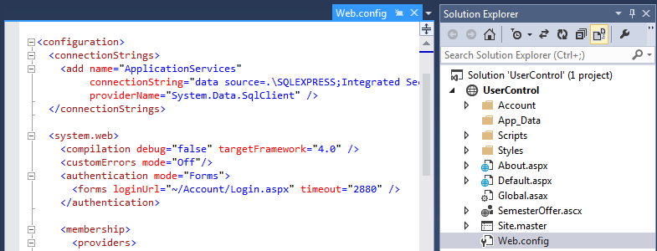
Before Deploying the Application into IIS
1. Open the Web.config file in Visual Studio and check
2. Change from
<authentication mode=“Windows"/>
To:
<authentication mode="Forms"/>
Or: <authentication mode=“None"/>

Slide 27
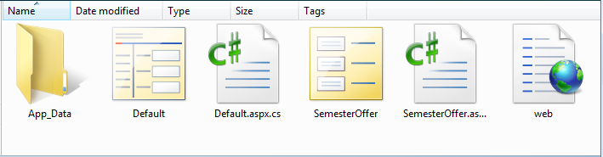
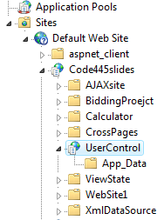
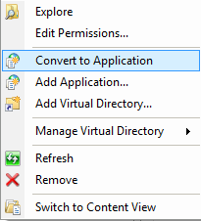
Folders and Files in the Application
UserControl
Create a virtual directory in IIS and link it to this directory “UserControl”
In W7 IIS: Right-click UserControl: and select: Convert to Application

Slide 28
Testing the .ascx Item in the aspx Page
In a Web browser, open:
http://localhost/Code445slides/UserControl/Default.aspx
Fall 2014
This semester and year change automatically.

Slide 29
ASPX File Creating the Web Form LoginPage.aspx
<%@ Register TagPrefix=“user” TagName=“LoginControl” src=“LoginControl.ascx” %>
<html>
<body>
<h1>User Control Demonstration</h1>
<hr>
<form runat="server">
<user:LoginControl ID=“MyLogin” BackColor=“#ccccff” RunAt=“server” />
</form>
<hr>
<h3><asp:Label ID=“Output” RunAt=“server” /></h3>
</body>
</html>
<script language=“C#” runat=“server”>
void Page_Load (Object sender, EventArgs e) {
if (IsPostBack)
Output.Text = “Hello, ” + MyLogin.UserName;
}
</script>

Slide 30

Another Example: LoginControl.ascx
LoginControl.ascx
<table id="MyTable" cellpadding="4" RunAt="server">
<tr> <td>User Name:</td>
<td><asp:TextBox ID=“MyUserName" RunAt="server" />
</td>
</tr>
<tr> <td>Password:</td>
<td><asp:TextBox ID=“MyPassword" TextMode="password" RunAt="server" />
</td>
</tr>
<tr> <td></td> <td><asp:LinkButton Text="Log In" RunAt="server" /></td> </tr>
</table>
<script language="C#" RunAt="server">
public string BackColor { get { return MyTable.BgColor; }
set { MyTable.BgColor = value; } }
public string UserName { get { return MyUserName.Text; }
set { MyUserName.Text = value; } }
public string Password { get { return MyPassword.Text; }
set { MyPassword.Text = value; } }
</script>

Slide 31
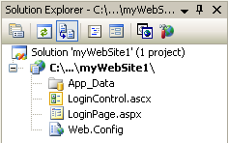
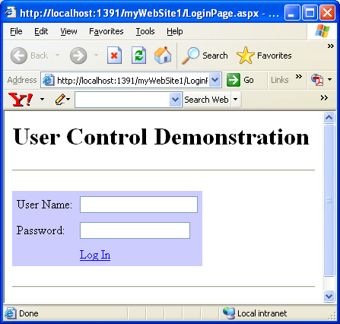
Putting ascx and aspx files into Website Project
Build
Start

Slide 32
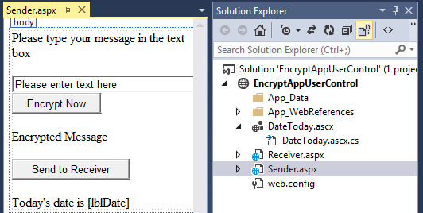
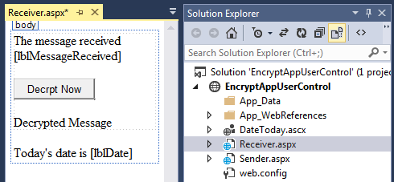
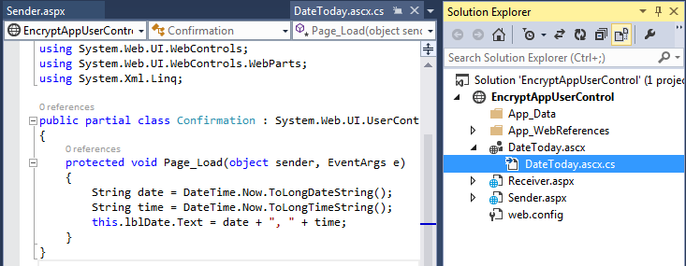
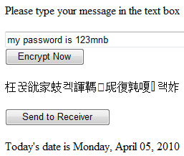
Sharing a User Control in Multiple Pages
User Control

